Slide 1


Full Stack Web Development

Slide 2
Welcome
Full-stack die-hards would consider a full-stack developer to have specialized knowledge in all stages of software development.

Slide 3
Our Agenda
Back End
Questions
Introduction
Front End
Web Careers
3

Slide 4

Hi I’m Ahmed Elnemr
A Full-Stack Developer multi-disciplinary
Instructor ( 3+ years experience),
Full-Stack Developer ( 2+ years experience) ,
Desktop Developer ( 3+ years experience),
Database Designer ( 3+ years experience) ,and
Database Developer ( 3+ years experience)
YouTube : Elnemr Code
LinkedIn : Ahmed Elnemr
E-mail : pro.ahmedelnemr@gmail.com
Phone : 02 0100 529 675 53
4

Slide 5
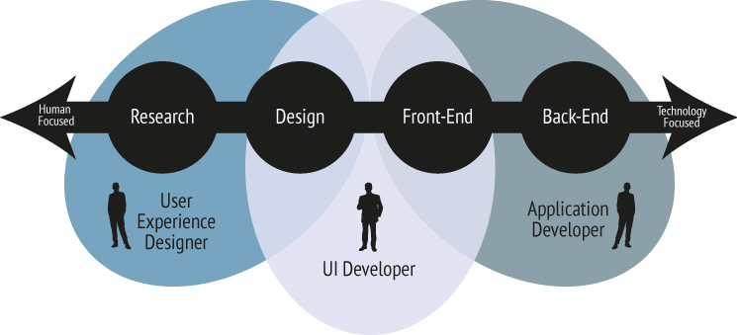

Web Development Careers

Slide 6

Web Development Careers

Slide 7
Course Roadmap
Trainee
Front-End
Learn the Basics
CSS
JavaScript
HTML
7

Slide 8
HTML
HTML is the standard markup language for creating Web pages.
8

Slide 9
HTML
HTML is the standard markup language for creating Web pages.
HTML stands for Hyper Text Markup Language.
HTML describes the structure of Web pages using markup.
HTML elements are the building blocks of HTML pages.
HTML elements are represented by tags.
HTML tags label pieces of content such as "heading", "paragraph", "table", and so on.
Browsers do not display the HTML tags, but use them to render the content of the page.
9

Slide 10
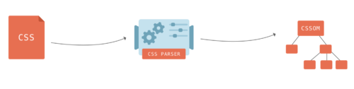
CSS
CSS stands for Cascading Style Sheets
10

Slide 11
CSS
CSS stands for Cascading Style Sheets
CSS is a language that describes the style of an HTML document.
CSS describes how HTML elements should be displayed.
11

Slide 12
JavaScript
JavaScript has become one of the most popular programming languages on the Web
12

Slide 13
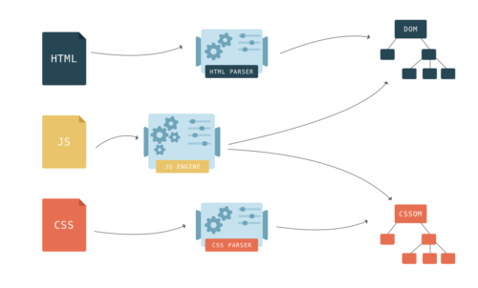
JavaScript
JavaScript has become one of the most popular programming languages on the Web
13

Slide 14
JavaScript
JavaScript has become one of the most popular programming languages on the Web
JavaScript is the programming language of HTML and the Web.
JavaScript is easy to learn.
14

Slide 15
Course Roadmap
Getting Deeper
CSS
JavaScript
Bootstrap
Materialize CSS
Foundation CSS
………………….
..
Flow DOM
JQuery
Ajax
15

Slide 16
Back-End
DBMS
PHP 7
Design Pattern
Core PHP
Ajax
Frameworks
16

Slide 17


17

Slide 18
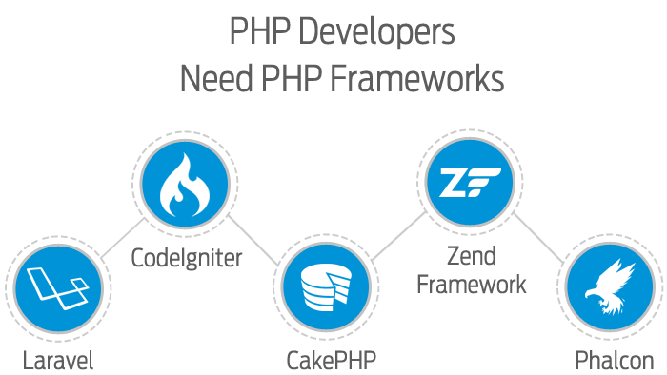

Slide 19




Slide 20


Slide 21
Get In Touch
Pro.ahmedelnemr@gmail.com
0100 52 967 53
facebook.com/deva7med
21

